Slide 1
LENDING LOAN CASE STUDY SUBMISSION
Swarnim Suman
Mythraye Subramanian

Slide 2
Lending Loan Case Study
Objective
Finance company wants to identify driving factor behind loan default.
Risks:
If the applicant is likely to repay the loan, then not approving the loan results in a loss of business to the company.
If the applicant is not likely to repay the loan, i.e. he/she is likely to default, then approving the loan may lead to a financial loss for the company.
Identify:
Identification of traits of Loan applicant that tends to “Credited Off”.
Understand driving factors behind loan default.

Slide 3
Methodology
Dataset Understanding
Data Cleaning
Remove Null/NA values
Remove columns which are not relevant
Remove irrelevant rows
Univariate Analysis
Summarize result
Bivariate Analysis

Slide 4
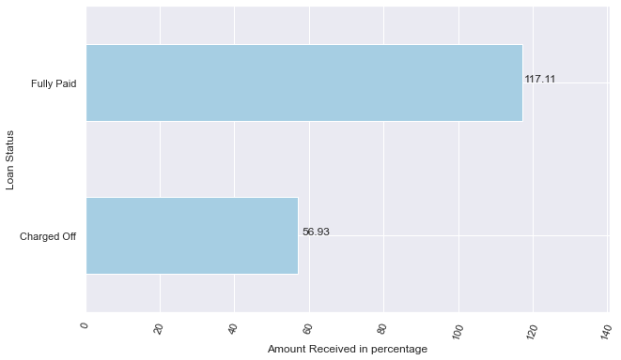
How this analysis is helpful?
When loan is fully paid, lending company makes 17% profit whereas loss of ~47% is incurred when applicant defaults

Slide 5
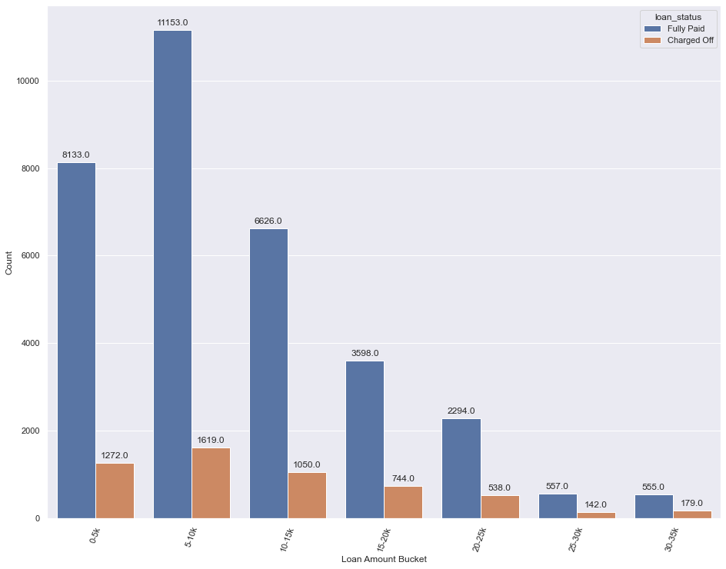
Loan Status vs Loan Amount
~20% and ~24% applicant defaulted in loan is between 25-30k and 30-35k respectively.

Slide 6
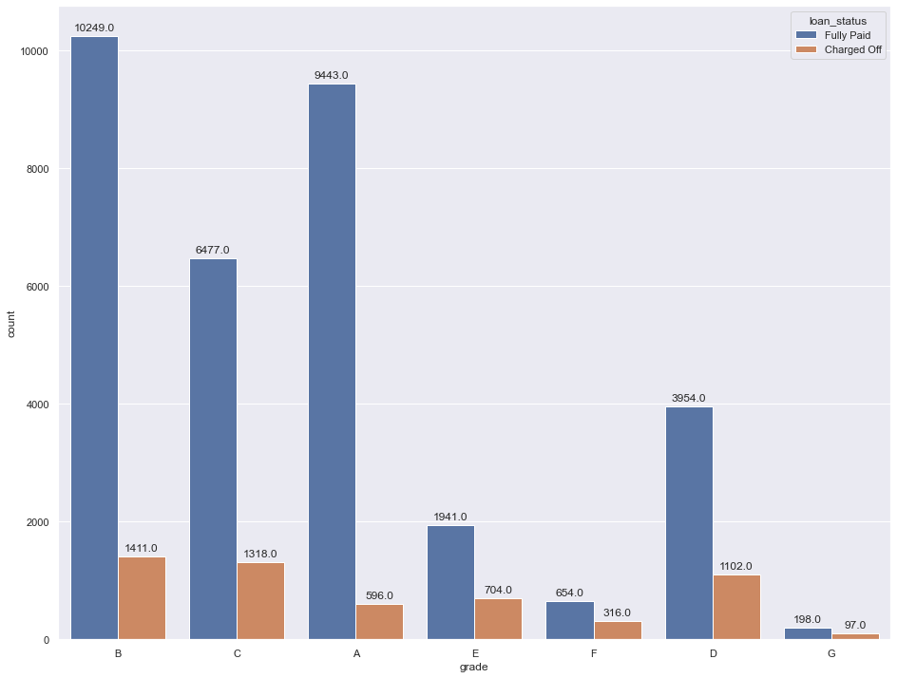
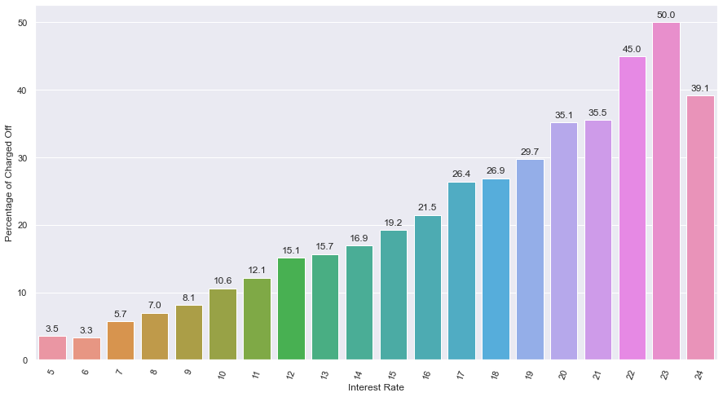
Loan Status vs Grade
More applicants default the loan as interest rate increases
~32% of applicant Charged Off in Grade D and G
>20% of applicant Charged Off in Grade E and F

Slide 7
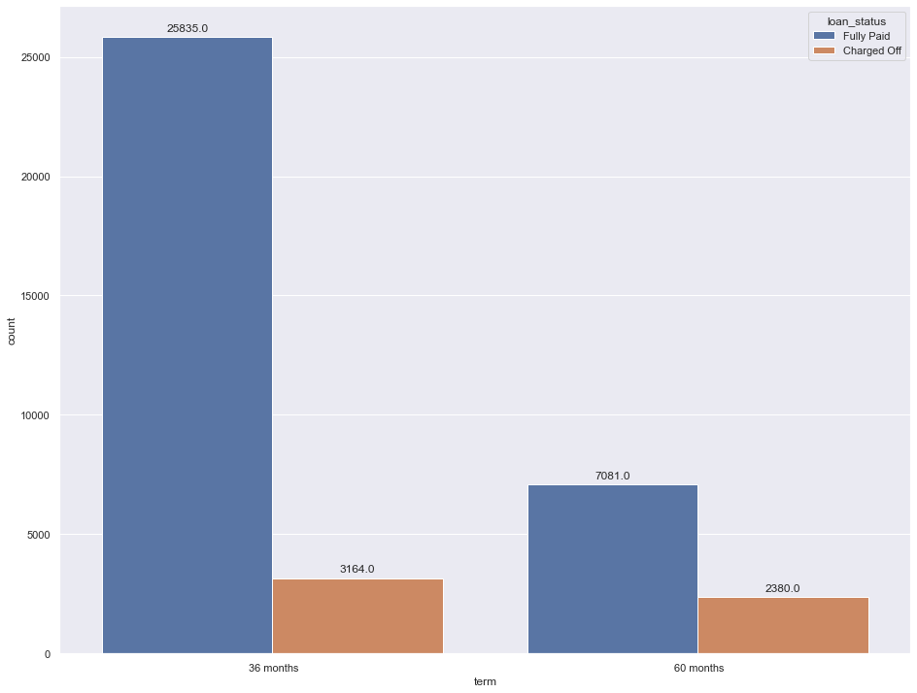
Loan status vs Term
~25% of applicants who took loan for 60 months terms are defaulter
~11% of applicant who took loan for 36 Months terms are defaulter

Slide 8
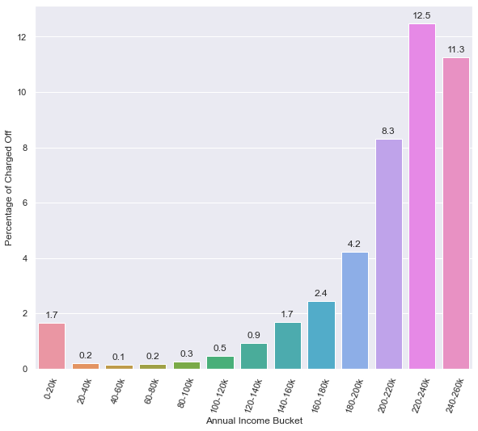
Annual Income vs Charged off

Slide 9
Conclusions
Based on the analysis of Lending data, we can conclude the following:
More applicant default if the amount is higher than 25k.
Applicant with lower grade have higher tendency of defaulting
Higher the interest rate, more applicant tends to default the loan
Higher the term value(60 Months), more people Charged off the loan

